Slide 1


Microsoft Query Store and Live Query Statistics overview:
Mission-critical performance with Microsoft SQL Server 2016
Speaker Name

Slide 2

Learning objectives
Query performance tools
Live Query Statistics overview
Live Query Statistics limitations and permissions
Query Store overview
Query Store architecture
Enabling and troubleshooting Query Store
Key scenarios and regressed queries
Query Store and Live Query Statistics hands-on lab

Slide 3
Query performance tools
1
Live Query Statistics (LQS)
2
Query Store

Slide 4
Live Query Statistics overview

Slide 5
Performance challenges
Problem
Difficult to troubleshoot “runaway” queries
Inability to get estimated plan without runtime information (for example, actual row counts, memory grant usage, execution time warnings)
Information on actual plan and time required for query to finish
Solution: Live Query Statistics/live query plan
Helps debug query performance issues
Shows what’s going on with long-running queries
Collects and displays actual metrics of in-flight queries in real time
Provides operator-level runtime execution statistics
Website is down
Temporary performance issues
Database upgraded
Database is not working
Impossible to predict / root cause
Regression caused by new bits
Plan choice change can cause these problems

Slide 6
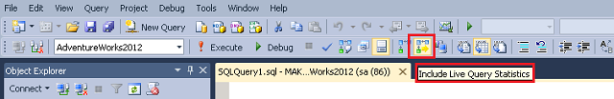
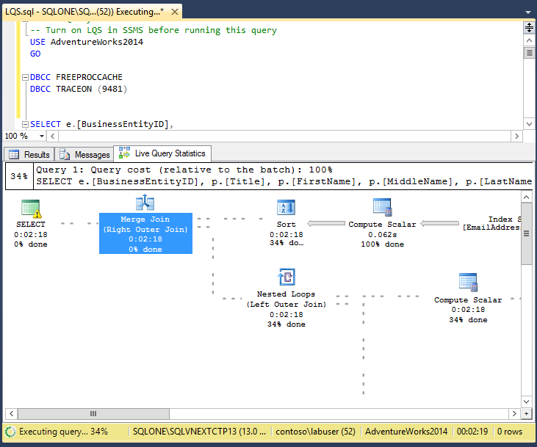
Live Query Statistics Collect actual metrics about query while running
To view live query execution plan, from Tools menu, click Live Query Statistics
Using LQS, you can view CPU/memory usage, execution time, query progress, and so on
Enables rapid identification of potential bottlenecks for troubleshooting query performance issues
Allows drill-down to live operator level statistics:
Number of generated rows
Elapsed time
Operator progress
Live warnings

Slide 7
How does it work?
Real-time showplan dynamic management views
sys.dm_exec_requests
sys.dm_exec_sql_text
sys.dm_exec_query_memory_grants
sys.dm_exec_query_plan
sys.dm_exec_query_profiles
Enable live query plan
In Management Studio, click Live Query Statistics or Query Store menu
SET STATISTICS XML ON or SET STATISTICS PROFILE ON in the session before the query is started
Enabling Extended Event query_post_execution_showplan
The event itself does not have to fire—it just needs to be enabled

Slide 8
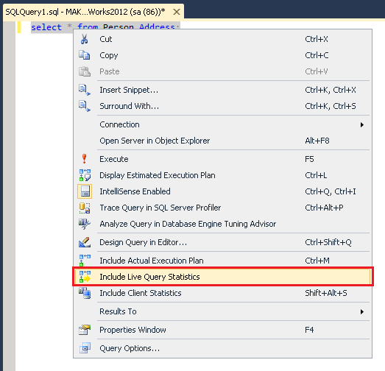
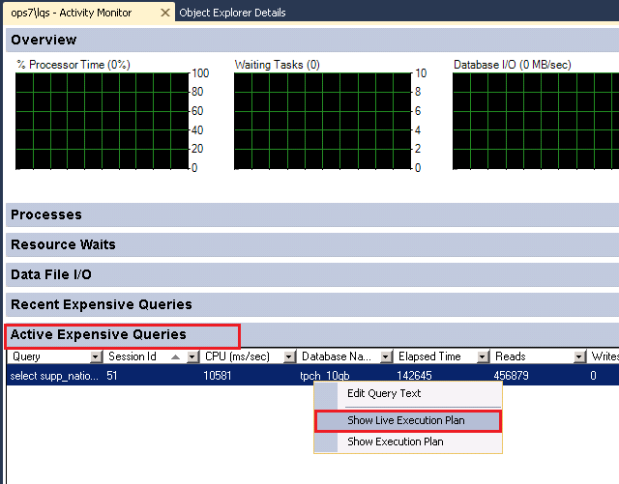
Other ways to view Live Query Statistics
In Management Studio, right-click selected query, and then click Include Live Query Statistics
In Activity Monitor, right-click queries in Active Expensive Queries table

Slide 9
Live Query Statistics limitations and permissions

Slide 10
Live Query Statistics limitations
Natively compiled stored procedures are not supported

Slide 11
Live Query Statistics permissions
Requires:
Database-level SHOWPLAN permission to populate Live Query Statistics results page
Server-level VIEW SERVER STATE permission to see live statistics
Any permissions necessary to execute query

Slide 12
Query Store overview

Slide 13
When performance is not good…
Website is down
Temporary performance issues
Database upgraded
Database is not working
Impossible to predict root cause
Regression caused by new bits
Change in query plan choice can cause these problems

Slide 14
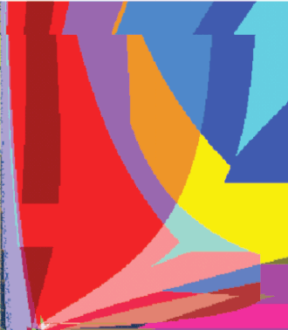
Query plan regression explained
SQL Server Query Optimizer considers many plans
As data and query parameters change, it might select a different plan as optimal
Usually when it crosses a boundary, performance is about the same
Actual performance can be visibly different
LINEITEM.L_EXTENDEDPRICE
0
20
40
60
80
100
0
20
40
60
80
100
SUPPLIER.S_ACCTBAL

Slide 15
Plan choice regression challenges
Plan cache is not well suited to performance troubleshooting
Long time to detect issue (TTD)
Which query is slow? Why is it slow?
What was previous plan?
Long time to mitigate (TTM)
Can I modify query?
How to use plan guide?

Slide 16
The solution: Query Store
Provides dedicated store for query workload performance data
Captures plan history for each query
Captures plan performance over time
Persists data to disk (works across restarts, upgrades, and recompiles)
Significantly reduces TTD/TTM
Offers power to find regressions and other issues in seconds
Allows you to force previous plans from history
Gives control to database administrator (DBA)

Slide 17
How Query Store works
SQL
Collects query texts (plus all relevant properties)
Stores all plan choices and performance metrics
Works across restarts/upgrades/recompiles
Lowers bar for performance troubleshooting
Allows new views
Offers intuitive and easy plan forcing
Compile
Plan store
Compile MSG
Query Store schema
Async write-back
Execute
Runtime stats
Execute MSG
Query Store
Durability latency controlled by DB option
DATA_FLUSH_INTERNAL_SECONDS

Slide 18
Query Store architecture

Slide 19
Query Store: write architecture
Query Store captures data in-memory to minimize I/O overhead
Data is persisted to disk asynchronously in background
Compile
Query Store plan store
Query text and plan
Internal tables
async
Execute
Runtime
stats store
Query execute stats
Query execution
Query Store

Slide 20
Query Store: read architecture
Views merge in-memory and on-disk content
Users always see “latest” data
Query Store views
Compile
Query Store plan store
Query text and plan
Internal tables
async
Execute
Runtime stats store
Query execute stats
Query execution
Query Store

Slide 21
Query Store schema explained
Internal tables
Exposed views
Query text
Query
Plan
Runtime stats
sys.
1 -n
1 -n
Compile stats
query_store_query_text
query_context_settings
query_store_query
query_store_plan
Context settings
Runtime stats interval
Runtime stats
query_store_runtime_stats_interval
query_store_runtime_stats
One row per query text, per plan affecting option
(example: ANSI NULLS on/off)
One row per plan (for each query)
One row per plan, per time interval (example: 5 min)

Slide 22
Stability during upgrade to SQL Server 2016
SQL Server 2016
Query optimization enhancements tied to database compatibility level
Install bits
Keep existing compat level
Run Query Store
(create a baseline)
Move to vNext CompatLevel
Fix regressions with plan forcing

Slide 23
Enabling and troubleshooting Query Store

Slide 24
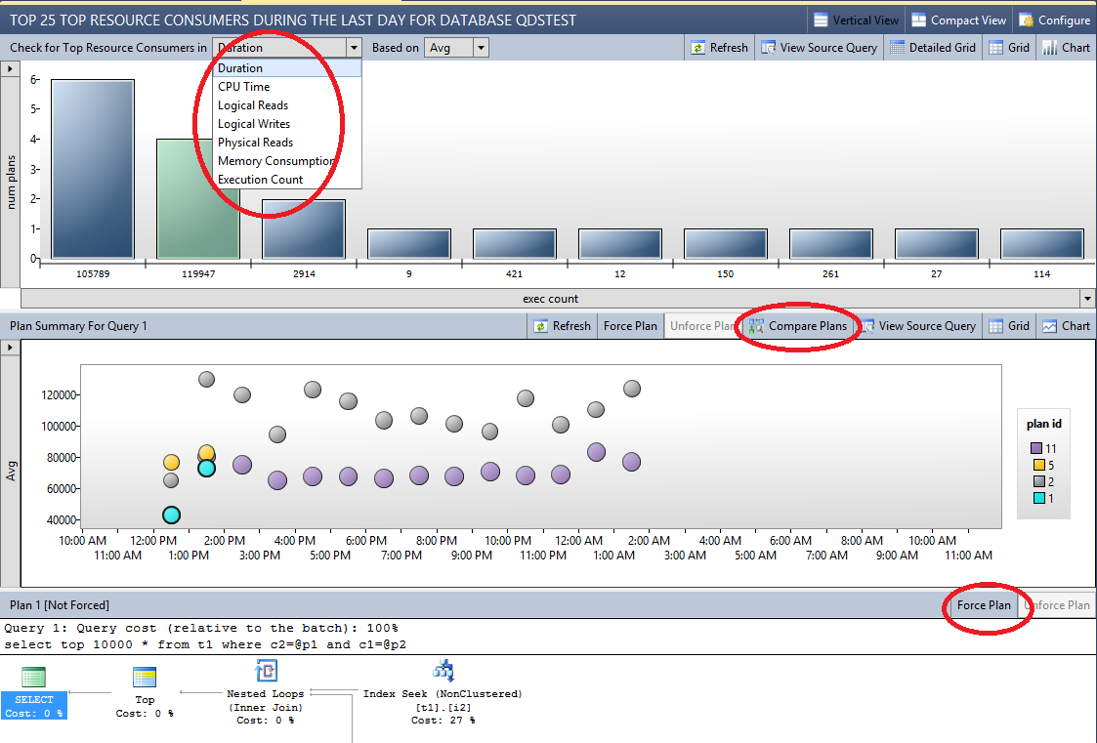
Monitoring query performance
Query Store feature provides DBAs with insight on query plan choice and performance
Regressed Queries pane shows queries and plans in Query Store
Drop-down boxes at top allow you to select queries based on various criteria

Slide 25
Troubleshooting query performance
Enable Query Store
(ALTER DB)
Let Query Store collect the data
Search for “problematic” queries
Set FORCE PLAN policies

Slide 26
Enabling Query Store
Query Store is not active for new databases by default
Using the Query Store page in Management Studio:
In Object Explorer, right-click a database, and then click Properties
In Database Properties dialog box, select Query Store page
In Enable box, select True
Using Transact-SQL Statements:
Use the ALTER DATABASE statement to enable Query Store
For example:
ALTER DATABASE AdventureWorks2012 SET QUERY_STORE = ON;

Slide 27
Key scenarios and
regressed queries

Slide 28
Key usage scenarios
Find and fix query plan regressions
Identify top resource consumers
Reduce risks with server upgrade
Conduct deep analysis of workload patterns/ performance
Short-term/tactical
Long-term/strategic

Slide 29
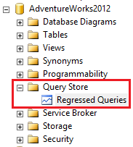
Using Regressed Queries feature
After enabling Query Store, refresh database portion of Object Explorer pane to add Query Store section

Slide 30
Hands-on lab (HOL)

Slide 31

© 2015 Microsoft Corporation. All rights reserved. Microsoft, Windows, Microsoft Azure, and other product names are or may be registered trademarks and/or trademarks in the U.S. and/or other countries. The information herein is for informational purposes only and represents the current view of Microsoft Corporation as of the date of this presentation. Because Microsoft must respond to changing market conditions, it should not be interpreted to be a commitment on the part of Microsoft, and Microsoft cannot guarantee the accuracy of any information provided after the date of this presentation. MICROSOFT MAKES NO WARRANTIES, EXPRESS, IMPLIED OR STATUTORY, AS TO THE INFORMATION IN THIS PRESENTATION

Slide 32



PolyBase overview
Mission-critical performance with Microsoft SQL Server 2016
Speaker Name

Slide 33

Learning objectives
Overview of PolyBase
What is PolyBase?
Why PolyBase?
PolyBase prerequisites
PolyBase hands-on lab
PolyBase use cases

Slide 34
Overview of PolyBase

Slide 35

PolyBase unites
Structured data
Unstructured data
Business data
…for a better-together world of analytics

Slide 36
Interest in big data
Increased number and variety of data sources that generate large quantities of data
Realization that data is “too valuable” to delete
Dramatic decline in cost of hardware, especially storage
Adoption of big-data technologies like Apache Hadoop

Slide 37
What is PolyBase?

Slide 38
What is PolyBase?
RDBMS
Hadoop
PolyBase
Provides a scalable, T-SQL-compatible query-processing framework for combining data from both universes
A channel between Hadoop and relational databases that allows users to query files (all structured, semi-structured, and unstructured) in Hadoop using familiar SQL language

Slide 39
Why PolyBase?

Slide 40
Why PolyBase?
Component of PDW region in APS
Transparent Database Encryption (TDE) and Always Encrypted
Highly parallelized, distributed query engine accessing heterogeneous data via SQL
Unique, innovative technology
Seamless integration

Slide 41
How it works
External table
User perspective
External data source
External file format
Systems perspective
PDW engine service
Bridge
Microsoft Azure

Slide 42
PolyBase benefits
Query relational and non-relational data with T-SQL
Capability
T-SQL for querying relational and non-relational data across Microsoft SQL Server and Hadoop
Benefits
New business insights across your Azure Data Lake
Leveraging of existing skill sets and BI tools
Faster time to insights and simplified ETL process
Query relational and non-relational data, on-premises and in Azure
T-SQL query
SQL Server
Hadoop
Apps

Slide 43
PolyBase view in SQL Server 2016
Allow SQL Server 2016 customers to execute T-SQL queries against relational data in SQL Server and “semi-structured” data in HDFS and Azure
Leverage existing T-SQL skills and BI tools to gain insights from different data stores
Expand reach of SQL Server to Hadoop (HDFS)
Query
Results
SQL Server
Hadoop
Azure Blob Storage

Slide 44
Capabilities and functions
Use T-SQL statements to access and query data in Hadoop or Azure Blob Storage
Use T-SQL to store data from Hadoop or Azure Blob Storage
Export data to Hadoop or Azure Blob Storage
Queries
PolyBase
Hadoop
Results
Users
Azure Blob Storage

Slide 45
Agnostic architecture
PolyBase is vendor independent
=
no vendor lock-in
PolyBase supports
Hadoop on Linux and Windows
PolyBase integrates with the cloud
PolyBase supports
HDInsight in APS and external Hadoop clusters

Slide 46
PolyBase builds a bridge
PolyBase = runtime integration
Includes Power BI
Just-in-time data integration
Best of both worlds
Existing analytical skills
Familiar query tools

Slide 47
PolyBase prerequisites

Slide 48
Prerequisites
64-bit SQL Server Evaluation Edition
External data source, either Windows Azure Blob Storage or supported Hadoop version
Microsoft .NET Framework 4.0
Oracle Java SE RunTime Environment (JRE) version 7.51 or higher (64-bit)
4 GB minimum memory
2 GB minimum hard-disk space

Slide 49
PolyBase scale-out groups
Head node
Compute node
Compute node
PolyBase queries
SQL Server
2016
SQL Server
2016
SQL Server
2016
PolyBase
Engine
PolyBase
DMS
PolyBase
DMS
PolyBase
DMS
PolyBase scale- out group
Name node
(HDFS
Data node
Data node
Data node
Data node
Hadoop cluster
File system
File system
File system
File system
Microsoft Developer Network, PolyBase groups for scale-out computation, https://msdn.microsoft.com/en-us/library/mt607030.aspx

Slide 50
PolyBase in CTP3
T-SQL query
SQL Server
Hadoop
Name
DOB
State
Jim Gray
11/13/58
WA
Ann Smith
04/29/76
ME

Slide 51
Hands-on lab (HOL)

Slide 52
Use cases

Slide 53
PolyBase use cases
Load data
Use Hadoop as an ETL tool to cleanse data before loading to data warehouse with PolyBase
Interactively query
Analyze relational data with semi-structured data using split-based query processing
Age-out data
Age-out data to HDFS and use it as “cold” but queryable storage

Slide 54
What’s the sweet spot for PolyBase?
 | Consumer | Analyst | Scientist
Data volume | Medium to low | Reasonable | High -> huge
Degree of structure | Very high | Some | Low -> none
Number of users | Very high | Medium | Low
Transformation complexity | Low | Medium to high | High
Analytics complexity | Low | Medium | Very high

Slide 55
PolyBase applications and scenarios
Application | Scenario | Benefits
Ad-hoc query scenario (combining relational and semi-structured data) | Semi-structured data sets stored in Hadoop or Azure Blob Storage Relational data set stored in SQL Server | Use of mature T-SQL to combine data sets via various JOIN expressions Improved query performance through pushdown computation for Hadoop data sources No sophisticated knowledge about Hadoop internals needed
Frequent BI reports | Focus on subset of data stored in Hadoop or Azure Blob Storage No frequent changes on this subset of data Series of reports needed on this subset of data | Parallelized import from Hadoop or Azure Blob Storage into SQL Server Ability to create column-store table anytime via T-SQL to leverage SQL Server’s world-class column-store technology Minimize time-to-insights No maintenance of separate ETL tool and code necessary
Ad-hoc query scenario (Hadoop data only) | Ad-hoc query against data stored in Hadoop or Azure Blob Storage | Use of mature T-SQL to run queries and combine data stored in different Hadoop systems or Azure storage containers No sophisticated knowledge about Hadoop internals needed

Slide 56

© 2015 Microsoft Corporation. All rights reserved. Microsoft, Windows, Microsoft Azure and other product names are or may be registered trademarks and/or trademarks in the U.S. and/or other countries. The information herein is for informational purposes only and represents the current view of Microsoft Corporation as of the date of this presentation. Because Microsoft must respond to changing market conditions, it should not be interpreted to be a commitment on the part of Microsoft, and Microsoft cannot guarantee the accuracy of any information provided after the date of this presentation. MICROSOFT MAKES NO WARRANTIES, EXPRESS, IMPLIED OR STATUTORY, AS TO THE INFORMATION IN THIS PRESENTATION

Slide 57


Row-Level Security and Dynamic Data Masking overview
Mission-critical performance with Microsoft SQL Server 2016
Speaker Name

Slide 58

Learning objectives
Row-Level Security overview
Row-Level Security benefits
Row-Level Security concepts
Row-Level Security walkthrough
Row-Level Security use cases
Dynamic Data Masking overview
Dynamic Data Masking benefits
Dynamic Data Masking walkthrough
Dynamic Data Masking limitations and restrictions
Dynamic Data Masking use cases
Row-Level Security hands-on lab

Slide 59
Row-Level Security overview

Slide 60
Need for Row-Level Security (RLS) Collect actual metrics about query while running
Enable fine-grained access control over specific rows in database table
Help prevent unauthorized access when multiple users share same tables, or implement connection filtering in multi-tenant applications
Administer via SQL Server Management Studio or SQL Server Data Tools
Use enforcement logic inside database and schema bound to table
Customer 1
Customer 2
Customer 3
SQL Database

Slide 61
RLS introduction
Shard 1
Shard 2
Tenant 1
Tenant 2
Tenant 3
Tenant 4
BlogID
Name
URL
Tenant
BlogID
Name
URL
Tenant
…
…
…
1
…
…
…
2
Row-Level security filters based on CONTEXT_INFO
…
…
…
3
…
…
…
2
…
…
…
3
…
…
…
4
Client App
Security Policy
Security Policy
Data dependent routing APIs connect to database
RLS restricts which users can view which data in a table, based on a function. SQL Server 2016 introduces this feature, which is useful in multi-tenant environments where you may want to limit data access based on customer ID.

Slide 62
Row-Level Security benefits

Slide 63
RLS benefits
RLS benefits
Fine-grained access control
Keeps multi-tenant databases secure by limiting access by other users who share same tables
Application transparency
Works transparently at query time, no app changes needed
Offers compatibility with RLS in other leading products
Centralized security logic
Increases security with enforcement logic residing inside database (schema-bound to table it protects)
Reduces application maintenance and complexity
Store data intended for many consumers in a single database/table, while at the same time restricting row-level read/write access based on users’ execution context

Slide 64
Row-Level Security concepts

Slide 65
RLS concepts
Performance?
Inline functions get optimized to provide comparable performance to views—as if the logic were directly embedded in the original query statement.
Predicate function
User-defined, inline table-valued function (iTVF) implementing security logic
Can be arbitrarily complicated, containing joins with other tables
Security predicate
Predicate function bound to particular table, applying it for all queries
Two types: filter predicates and blocking predicates
Security policy
Collection of security predicates for managing security across multiple tables
CREATE SECURITY POLICY mySecurityPolicy
ADD FILTER PREDICATE dbo.fn_securitypredicate(wing, startTime, endTime)
ON dbo.patients

Slide 66
Row-Level Security walkthrough

Slide 67
RLS in three steps
Nurse
Policy manager
Database
Security
Policy
Filter Predicate:
INNER JOIN…
Application
CREATE FUNCTION dbo.fn_securitypredicate(@wing int)
RETURNS TABLE WITH SCHEMABINDING AS
return SELECT 1 as [fn_securitypredicate_result] FROM
StaffDuties d INNER JOIN Employees e
ON (d.EmpId = e.EmpId)
WHERE e.UserSID = SUSER_SID() AND @wing = d.Wing;
CREATE SECURITY POLICY dbo.SecPol
ADD FILTER PREDICATE dbo.fn_securitypredicate(Wing) ON Patients
WITH (STATE = ON)
Patients
SELECT * FROM Patients
SELECT * FROM Patients
SEMIJOIN APPLY dbo.fn_securitypredicate(patients.Wing);
SELECT Patients.* FROM Patients,
StaffDuties d INNER JOIN Employees e ON (d.EmpId = e.EmpId)
WHERE e.UserSID = SUSER_SID() AND Patients.wing = d.Wing;
One Policy manager creates filter predicate and security policy in T-SQL, binding predicate to patient’s table
Two App user (nurse) selects from patient’s table
Three Security policy transparently rewrites query to apply filter predicate

Slide 68
Create security policy
Creates security policy for Row-Level Security
These examples demonstrate the use of CREATE SECURITY POLICY syntax
-- The following syntax creates a security policy with a filter predicate for the Customer table, and leaves the security policy disabled
CREATE SECURITY POLICY [FederatedSecurityPolicy]
ADD FILTER PREDICATE [rls].[fn_securitypredicate]([CustomerId])
ON [dbo].[Customer];
-- Create a new schema and predicate function, which will use the application user ID stored in CONTEXT_INFO to filter rows.
CREATE FUNCTION rls.fn_securitypredicate (@AppUserId int)
RETURNS TABLE
WITH SCHEMABINDING
AS
RETURN (
SELECT 1 AS fn_securitypredicate_result
WHERE
DATABASE_PRINCIPAL_ID() = DATABASE_PRINCIPAL_ID('dbo') -- application context
AND CONTEXT_INFO() = CONVERT(VARBINARY(128), @AppUserId);
GO

Slide 69
Security predicates
RLS supports two types of security predicates
Filter predicates silently filter rows available to read operations (SELECT, UPDATE, and DELETE)
Block predicates explicitly block write operations (AFTER INSERT, AFTER UPDATE, BEFORE UPDATE, BEFORE DELETE) that violate predicate*
Access to row-level data in table is restricted by security predicate defined as inline table-valued function, which is invoked and enforced by security policy
For filter predicates, no indication to application that rows have been filtered from result set; if all rows are filtered, a null set will be returned
For block predicates, any operations that violate predicate will fail with error
* At this time, block predicates are only available as a preview in SQL Database V12.

Slide 70
Row-Level Security
use cases

Slide 71
Common RLS use cases
Traditional RLS workloads
Custom business logic to determine which rows each user can SELECT, INSERT, UPDATE, or DELETE based on role, department, security level, and so on
Target sectors: Examples include finance, insurance, health care, oil/gas, federal
Multi-tenant databases
Ensuring tenants can only access their own rows of data in shared database, with enforcement logic in database rather than in app tier
One example is multi-tenant shards with elastic database tools on SQL Database
Reporting, analytics, data warehousing
Different users access same database through various reporting tools, and work with different subsets of data based on identity/role

Slide 72
Dynamic Data
Masking overview

Slide 73
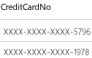
Dynamic Data Masking Prevent abuse of sensitive data by hiding it from users
Dynamic Data Masking
Configuration made easy in new Azure portal
Policy-driven at table and column level for defined set of users
Dynamic Data Masking applied in real time to query results based on policy
Multiple masking functions available (full, partial) for various sensitive data categories (like credit card numbers, SSN)
Table.CreditCardNo
4465-6571-7868-5796
4468-7746-3848-1978
4484-5434-6858-6550
SQL Database
SQL Server 2016
Real-time data masking; partial masking

Slide 74
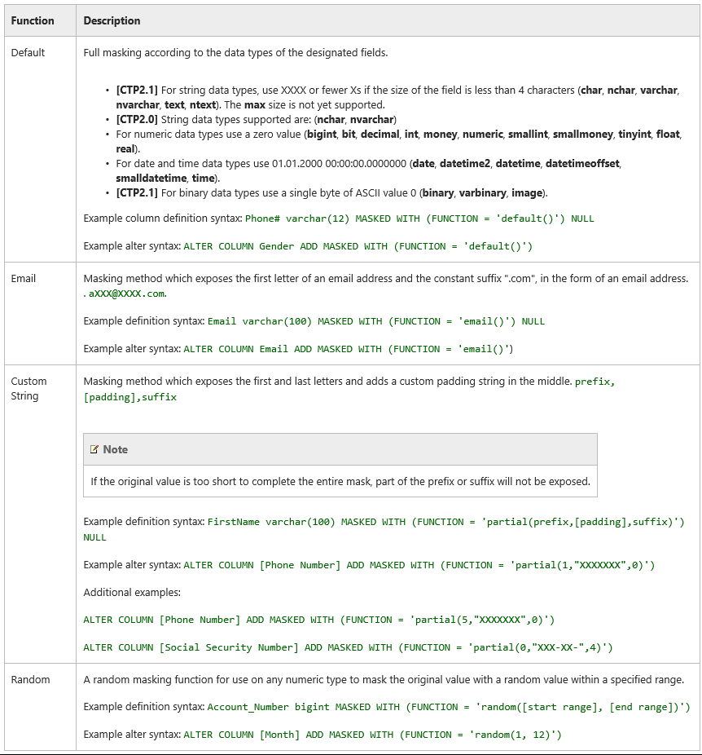
Defining Dynamic Data Masking
A masking rule may be defined on a column in a table in order to protect data in that column.
Four types of masks are available.
A masking rule may be defined on a column in a table, in order to protect data in that column. Four types of masks are available.

Slide 75
Dynamic Data
Masking benefits

Slide 76
Benefits of Dynamic Data Masking
Regulatory compliance
Strong demand for applications to meet privacy standards recommended by regulating authorities
Sensitive data protection
Protection against unauthorized access to sensitive data in application, and against exposure to developers or DBAs who need access to production database
Agility and transparency
Data is masked anytime, anywhere, with underlying data in database remaining intact
Transparent to application and applied according to user privilege maintenance and complexity
Limit access to sensitive data by defining policies to obfuscate specific database fields, without affecting database integrity

Slide 77
Dynamic Data Masking walkthrough

Slide 78
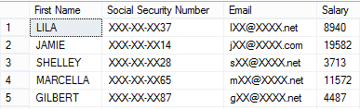
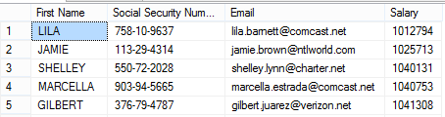
Dynamic Data Masking walkthrough
2 ) App user selects from employee table
1 ) Security officer defines dynamic data-masking policy in T-SQL over sensitive data in employee table
3 ) Dynamic data-masking policy obfuscates sensitive data in query results
ALTER TABLE [Employee] ALTER COLUMN [SocialSecurityNumber]
ADD MASKED WITH (FUNCTION = ‘SSN()’)
ALTER TABLE [Employee] ALTER COLUMN [Email]
ADD MASKED WITH (FUNCTION = ‘EMAIL()’)
ALTER TABLE [Employee] ALTER COLUMN [Salary]
ADD MASKED WITH (FUNCTION = ‘RANDOM(1,20000)’)
GRANT UNMASK to admin1
BUSINESS APP
BUSINESS APP
Security
Officer
other login
admin1 login
SELECT [Name], [SocialSecurityNumber],
[Email],
[Salary]
FROM [Employee]

Slide 79
Querying for masked columns
Use sys.masked_columns view to query for table columns that have a masking function applied to them.
This view inherits from sys.columns view. It returns all columns in sys.columns view, plus is_masked and masking_function columns—indicating if a column is masked, and if so, what masking function is defined.
This view only shows columns on which there is a masking function applied.
SELECT c.name, tbl.name as table_name, c.is_masked, c.masking_function
FROM sys.masked_columns AS c
JOIN sys.tables AS tbl
ON c.[object_id] = tbl.[object_id]
WHERE is_masked = 1;

Slide 80
Dynamic Data Masking limitations and restrictions

Slide 81
Limitations and restrictions
A masking rule cannot be defined for the following column types:
Encrypted columns (Always Encrypted)
FILESTREAM
COLUMN_SET
For users without UNMASK permission, deprecated READTEXT, UPDATETEXT, and WRITETEXT statements do not function properly on a column configured for Dynamic Data Masking

Slide 82
Dynamic Data Masking use cases

Slide 83
Dynamic Data Masking: common use cases
Using SELECT INTO or INSERT INTO to copy data from a masked column into another table results in masked data in the target table
Dynamic Data Masking is applied when running SQL Server Import and Export
A database containing masked columns will result in a backup file with masked data (assuming it is exported by a user without UNMASK privileges), and the imported database will contain statically masked data

Slide 84
Hands-on lab (HOL)

Slide 85
© 2015 Microsoft Corporation. All rights reserved. Microsoft, Windows, Microsoft Azure, and other product names are or may be registered trademarks and/or trademarks in the U.S. and/or other countries. The information herein is for informational purposes only and represents the current view of Microsoft Corporation as of the date of this presentation. Because Microsoft must respond to changing market conditions, it should not be interpreted to be a commitment on the part of Microsoft, and Microsoft cannot guarantee the accuracy of any information provided after the date of this presentation. MICROSOFT MAKES NO WARRANTIES, EXPRESS, IMPLIED OR STATUTORY, AS TO THE INFORMATION IN THIS PRESENTATION

Slide 86
Assorted examples

Slide 87
Example 1: Creating a dynamic data mask
The following example creates a table with three different types of dynamic data masks. The example populates the table and selects to show the result.
CREATE TABLE Membership
(MemberID int IDENTITY PRIMARY KEY,
FirstName varchar(100) MASKED WITH (FUNCTION = 'partial(1,"XXXXXXX",0)') NULL,
LastName varchar(100) NOT NULL,
Phone# varchar(12) MASKED WITH (FUNCTION = 'default()') NULL,
Email varchar(100) MASKED WITH (FUNCTION = 'email()') NULL);
INSERT Membership (FirstName, LastName, Phone#, Email) VALUES
('Roberto', 'Tamburello', '555.123.4567', 'RTamburello@contoso.com'),
('Janice', 'Galvin', '555.123.4568', 'JGalvin@contoso.com.co'),
('Zheng', 'Mu', '555.123.4569', 'ZMu@contoso.net');
SELECT * FROM Membership;

Slide 88
Example 1: Creating a dynamic data mask
A new user is created and granted SELECT permission on the table. Queries executed as the TestUser view masked data.
CREATE USER TestUser WITHOUT LOGIN;
GRANT SELECT ON Membership TO TestUser;
EXECUTE AS USER = 'TestUser';
SELECT * FROM Membership;
REVERT;
The result demonstrates the masks by changing the data from
1 Roberto Tamburello 555.123.4567 RTamburello@contoso.com
into
1 RXXXXXXX Tamburello xxxx RXXX@XXXX.com

Slide 89
Example 2: Adding or editing a mask on an existing column
Use the ALTER TABLE statement to add a mask to an existing column in the table, or to edit the mask on that column. The following example adds a masking function to the LastName column:
ALTER TABLE Membership
ALTER COLUMN LastName ADD MASKED WITH (FUNCTION = 'partial(2,"XXX",0)');
The following example changes a masking function on the LastName column:
ALTER TABLE Membership
ALTER COLUMN LastName varchar(100) MASKED WITH (FUNCTION = 'default()');

Slide 90
Example 3: Granting permission to view unmasked data
Granting UNMASK permission allows TestUser to see data unmasked.
GRANT UNMASK TO TestUser;
EXECUTE AS USER = 'TestUser';
SELECT * FROM Membership;
REVERT;
-- Removing the UNMASK permission
REVOKE UNMASK TO TestUser;

Slide 91
Example 4: Dropping a dynamic data mask
The following statement drops the mask on the LastName column created in the previous example:
ALTER TABLE Membership
ALTER COLUMN LastName DROP MASKED;

Slide 92

High availability and disaster recovery with Microsoft Azure VMs overview:
Mission-critical performance with SQL Server 2016
Speaker Name

Slide 93
Learning objectives
Overview of high availability and disaster recovery
Backup to Azure blob blocks
Backup to Azure with file snapshots
SQL Server Managed Backup to Azure
AlwaysOn replica in Azure Virtual Machines
High availability and disaster recovery demo

Slide 94
Overview of high availability and disaster recovery

Slide 95
SQL Server on-premises with cloud resources
Backup to Azure Storage
Optionally managed
Data files in Azure Storage using file snapshots
On-premises
Microsoft Azure
Azure Storage
AlwaysOn replica in Azure Virtual Machines
Primary
Secondary

Slide 96
Benefits of Azure Backup
Block blobs
Reduced storage costs
Significantly improved restore performance
More granular control over Azure Storage
Azure Storage snapshot backup
Fastest method for creating backups and running restores
Support of SQL Server database files on Azure Blob Storage
Managed backup
Granular control of the backup schedule
Local staging for faster recovery and greater network resiliency
System database support
Simple recovery mode support

Slide 97
Backup to Azure block blobs
Backup to Azure block blobs

Slide 98
Backup to Azure
SQL Server 2012 SP1 CU2
BACKUP database TO URL = ‘https://<storageaccount>.blob.core.windows.net/<container>/<blob>’
WITH CREDENTIAL = ‘credential_name’
Azure Virtual Machines
Azure Storage
On-premises
Benefits
Near “bottomless” storage
Off-site, geo-redundant
No provisioning, decay free
No device management
Remote accessibility
Limitations
Backup size up to 1 TB
Restore speed
On-premises
On-site and off-site storage costs
Device management costs
Azure
Limit of 1 TB on Azure drive
Max of 16 drives
Management of drives and policy

Slide 99
Backup to Azure block blobs
SQL Server 2016
Less expensive storage
Backup stripping and faster restore
Approximate maximum backup size of 12 TB
Granular access and unified credential story (SAS URIs)
Supports all existing backup and restore features (except append)
CREATE CREDENTIAL [https://<account>.blob.core.windows.net/<container>]
WITH IDENTITY = 'Shared Access Signature',
SECRET = 'sig=mw3K6dpwV%2BWUPj8L4Dq3cyNxCI'
BACKUP DATABASE database TO
URL = N'https://<account>.blob.core.windows.net/<container>/<blob1>',
URL = N'https://<account>.blob.core.windows.net/<container>/<blob2>'

Slide 100
Usage scenarios
Recovery
Dev/Test
Data
Media failure or undesired action (for example, DROP TABLE)
Restore to any on-premises SQL Server database
Inexpensive disaster recovery
Restore to an Azure virtual machine and redirect applications
Restore to an Azure virtual machine and give access to developers

Slide 101
Backup to Azure with file snapshots

Slide 102
SQL Server data files in Azure
SQL Server 2014
Near “bottomless” storage
Off-site, geo-redundant
No provisioning
No device management
Media safety (decay free)
Remote accessibility
Native support for SQL Server data files stored as Azure blobs
DB1
DB2
DB3
DB3
Azure Virtual Machines
Azure Storage
DB4
DB5
DB6
DB6
On-premises
CREATE CREDENTIAL [https://mystorage.blog.core.windows.net/data]
WITH IDENTITY = ‘Shared Access Signature',
SECRET = ‘<your SAS key>
CREATE DATABASE mydb ON
( NAME = mydb_dat,
FILENAME = 'https://mystorage.blob.core.windows.net/data/mydb.mdf' )
LOG ON
( NAME = foo_log,
FILENAME = 'https://mystorage.blob.core.windows.net/data/mydblog.ldf')
Separation of compute and storage
Database migration to other machines
Basic disaster recovery
Increased storage on Azure Virtual Machines

Slide 103
SQL Server 2016: Backup to Azure with file snapshots
SQL Server data files
MDF
MDF
BAK
LDF
LDF
Database
Azure Storage
BACKUP DATABASE database TO URL = N'https://<account>.blob.core.windows.net/<container>/<backupfileblob1>‘ WITH FILE_SNAPSHOT

Slide 104
Point-in-time restore with file snapshots
SQL Server 2016
Full
Log
Log
Log
Diff
Log
Log
Log
Diff
Log
Log
Log
Traditional backup
Multiple backup types
Complex point-in-time restore process
Full
Log
Log
Log
Log
Log
Log
Log
Log
Log
Log
Log
Backup to Azure with file snapshots
Full backup only once
Point-in-time restore only needs two adjacent backups

Slide 105
Backup to Azure with file snapshots
Benefits
Fastest way to back up and restore
Faster than backing up to block blobs (no data move)
Faster than Volume Copy Shadow Service backups (no need for log backups)
Least expensive option (no full copies)
Convenient and intuitive
Notes
Only works with SQL database files in Azure Storage
Some restrictions with snapshots of SQL database files
The number of snapshots needs to be controlled to avoid performance regression
Backup encryption checks for transparent data encryption, not encrypts

Slide 106
SQL Server Managed Backup to Azure

Slide 107
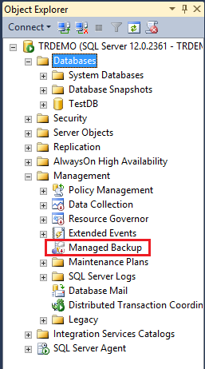
SQL Server 2014 Managed Backup to Azure
What is it?
An agent that manages and automates SQL Server backup policy
Benefits
Simple and flexible
Minimal input (controls retention period)
Manages entire instance or individual databases
Leverages backup to Azure (page blob)
Supports backup encryption
Inherently off-site and geo-redundant
Minimal storage cost and hardware management
Built-in intelligence
Retention
Context-aware (for example, workload/throttling)
Backups consider log accumulation
Example:
EXEC smart_admin.sp_set_db_backup
@database_name='TestDB',
@retention_days=30,
@credential_name='MyCredential',
@encryption_algorithm='NO_ENCRYPTION',
@enable_backup=1
GO

Slide 108
Managed Backup to Azure in SQL Server 2014
Prerequisites
SQL credential based on Azure Storage account
Enable SQL Server Agent
Backup logic
Full: 1 week, or 1 GB log growth; initial and log chain broken
Log: 2 hours, or 5 MB log growth
Retention
Up to 30 days (capable of point-in-time recovery)
Limitations
Full and log backups only
Recovery models: full or bulk-logged
User databases only
Max backup size of 1 TB (Azure page blob limit)

Slide 109
Managed Backup to Azure in SQL Server 2016
Supports system databases
Supports databases in simple recovery mode
Leverages backup to block blobs for more granular control
Allows customized backup schedules for full backup and log backup

Slide 110
Customized scheduling
Step 1: Run the Scheduling stored procedure to configure custom scheduling
EXEC Managed_Backup.sp_backup_config_schedule
@database_name = 'testDB'
,@scheduling_option= 'Custom'
,@full_backup_freq_type = 'weekly’
,@days_of_week = 'Saturday'
,@backup_begin_time = '11:00'
,@backup_duration = '02:00'
,@log_backup_freq = '00:05'
Step 2: Run the Basic stored procedure to configure Managed Backup
EXEC msdb.managed_backup.sp_backup_config_basic
@database_name= 'testDB',
@enable_backup=1,
@container_url='https://storage account name.blob.core.windows.net/container name',
@retention_days=30

Slide 111
SQL Server 2016 Managed Backup
Scheduling
Ability to choose when to take full backups and how often to take log backups
Staging
Keeps a local copy of the last part of the backup chain
SQL Server
Full backup
Log backup
Asynchronous copy
Full backup
Full backup
Log backup
Log backup
On-premises
Azure Storage

Slide 112
AlwaysOn replica in Azure Virtual Machines

Slide 113
AlwaysOn replicas in Azure Virtual Machines
Extend AlwaysOn Availability Groups with replicas in Azure Virtual Machines
Benefits
Low total cost of ownership
For Azure Virtual Machines and Storage only; free ingress traffic
No disaster recovery site cost (rent, hardware, operations)
Transparent application failover
Available replicas to offload read workloads and backups
Any Azure region (America, Europe, Asia)
Azure Storage guarantees no data loss
Azure Virtual Machines is highly available
Microsoft Azure
On-premises

Slide 114
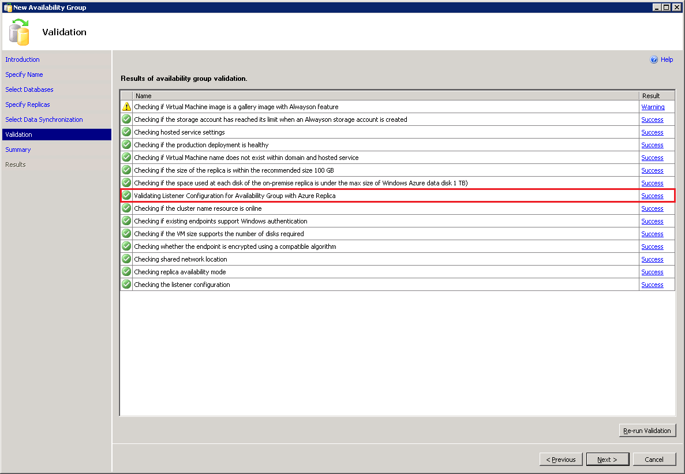
Simplified Add Azure Replica Wizard
Automatic Listener Configuration
Today:
Requires manual configuration of the Listener
In SQL Server 2016:
Ability to configure the Availability Group Listener in Azure
Clients can connect to the Azure replica after failover using the Listener name

Slide 115
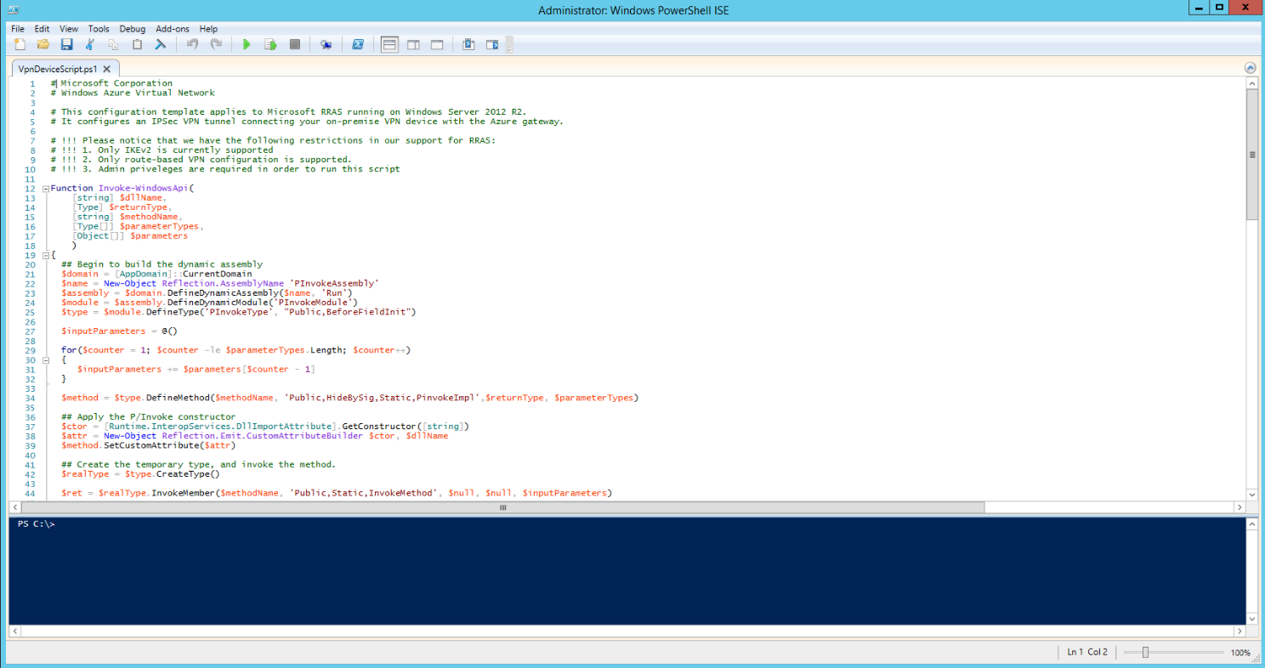
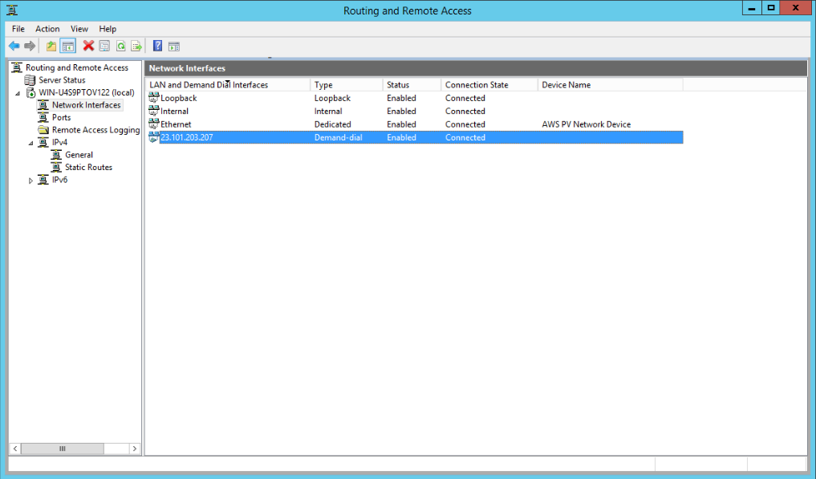
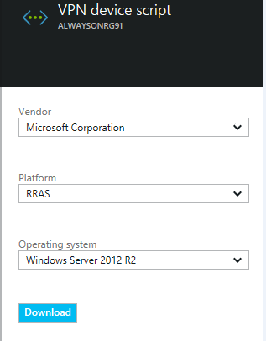
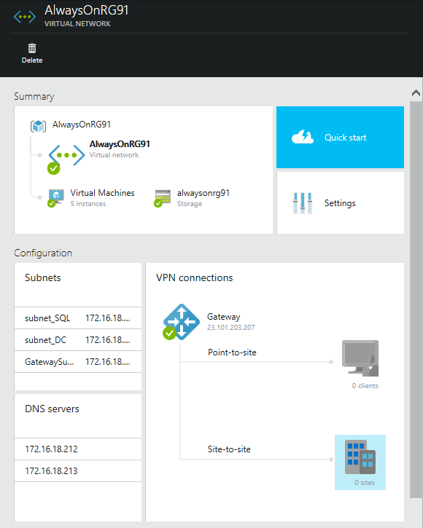
Before extending AlwaysOn configuration
Configure site-to-site VPN tunnel between on-premises SQL Server and Azure
Tutorial: http://msdn.microsoft.com/en-us/library/dn636917.aspx

Slide 116
AlwaysOn replica in Azure
Sample deployment
Availability Group
Virtual Network
S1
VPN Tunnel
S2
P
AD/DNS
VPN Device
VPN Gateway
AGCloudReplica
On-premises
Microsoft Azure

Slide 117
AlwaysOn replica in Azure Virtual Machines
Usage scenarios
Disaster recovery
Manually fails over to (warm) secondary replica
Offloads from the primary machine
Reads workloads (Reporting, BI)
Backs up data (compliance)

Slide 118
Demo

Slide 119
© 2015 Microsoft Corporation. All rights reserved. Microsoft, Windows, Microsoft Azure, and other product names are or may be registered trademarks and/or trademarks in the U.S. and/or other countries. The information herein is for informational purposes only and represents the current view of Microsoft Corporation as of the date of this presentation. Because Microsoft must respond to changing market conditions, it should not be interpreted to be a commitment on the part of Microsoft, and Microsoft cannot guarantee the accuracy of any information provided after the date of this presentation. MICROSOFT MAKES NO WARRANTIES, EXPRESS, IMPLIED OR STATUTORY, AS TO THE INFORMATION IN THIS PRESENTATION

